Slide 1
Pandemic and Retail
How Pandemic affected retail

Slide 2
Ryan

Slide 5
Bilikisu
Pandemic affected the whole word and not just the retail.
We look at the following sectors of retail
Department_Stores
Electronics_Appli
Food_Serv_Drink
Food_Beverage
Furniture_HomeFurnis
Health_Personal_Care
Retail was mostly affected due to the lockdown and both consumer and retail store have to pivot to online e-commerce.
The below plot show the pre-pandemic sales and the dip across all over different area of retail.

Slide 6
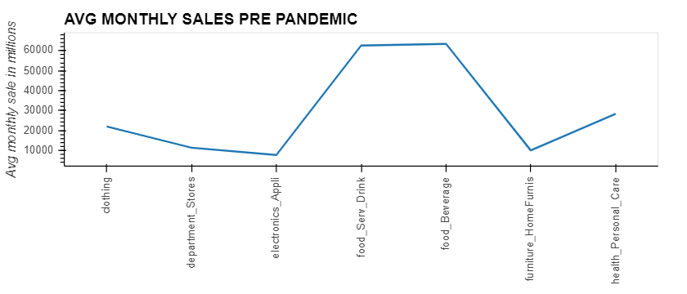
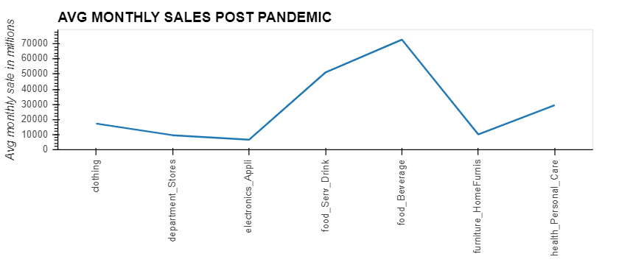

Slide 9
Frank

Slide 14
Quang

